Slide 1
The Roaring 20s & The Jazz Age/Culture in the 1920s
By Flavia, Linda and Kathy

Slide 2
The 1920s were marked by economic prosperity, advances in technology and culture, and changing social roles.

Slide 3
Jazz/Music
Jazz music of the 1920s established jazz as a music genre. Many changes, improvisations, and experiments have taken place in jazz music since then.

Slide 4
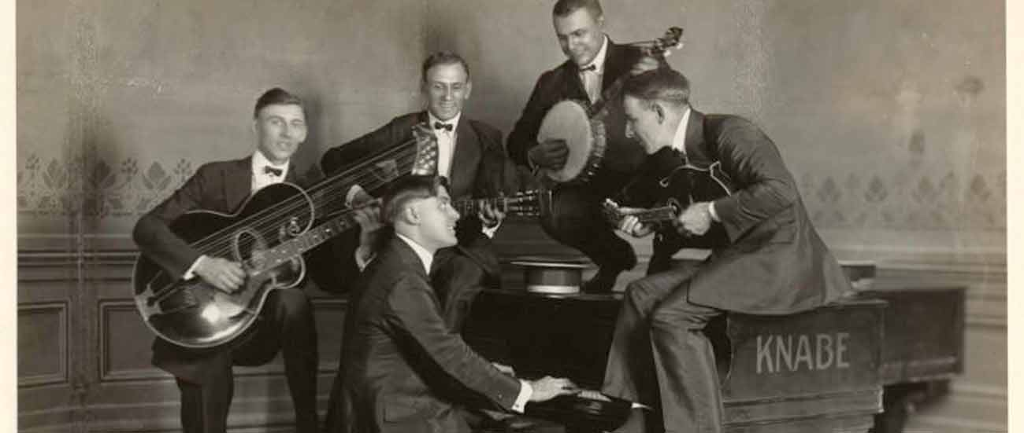
Jazz Music
Jazz gained popularity in America and worldwide by the 1920s. Nothing quite like it had ever happened before in America. New exuberant dances were devised to take advantage of the upbeat tempo's of Jazz and Ragtime music.
Jazz, Ragtime and Broadway musicals became popular.

Slide 5
Dance
Jazz dance was an extension of jazz music and it was one of the many art forms that came out of the Harlem Renaissance during the 1920s in America. Jazz dance could be considered the origin of many popular American dances that have carried on through decades worldwide--even today.

Slide 6
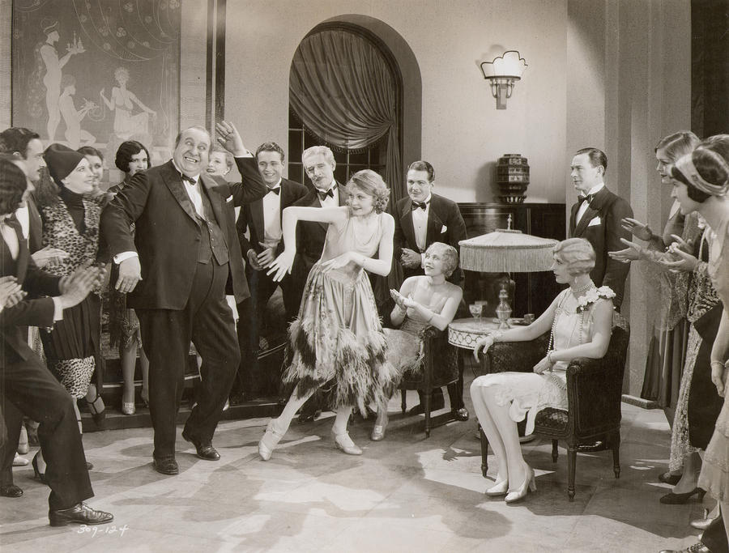
Dance
Jazz dance is an American form of dance that developed in the early 1900’s as both African and European peoples began to mix their dance traditions. Africans focused on rhythms and torso movement and Europeans on musical harmonies, folk and social dances.

Slide 7
The powerful economic might of America from 1920 to October 1929 is frequently overlooked or simply submerged by the more exciting topics such as Prohibition and the gangsters, the Jazz Age with its crazies, the KKK etc. However, the strength of America was generated and driven by its vast economic power.

Slide 8
CARS
A good example was the motor car industry. The 3 big producers were Ford, Chrysler and General Motors.

Slide 9
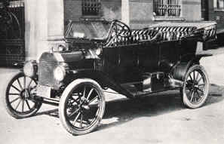
A boom in the car industry came from Ford’s with the legendary Ford Model -T.
This was a car for the people. It was cheap; mass production had dropped its price to just $295 in 1928. The same car had cost $1200 in 1909. By 1928, just about 20% of all Americans had cars.

Slide 10
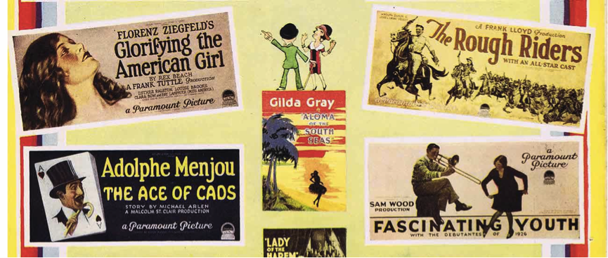
Movies
The 1920's was largely dominated by silent movies but saw the introduction of synchronized sound.

Slide 11
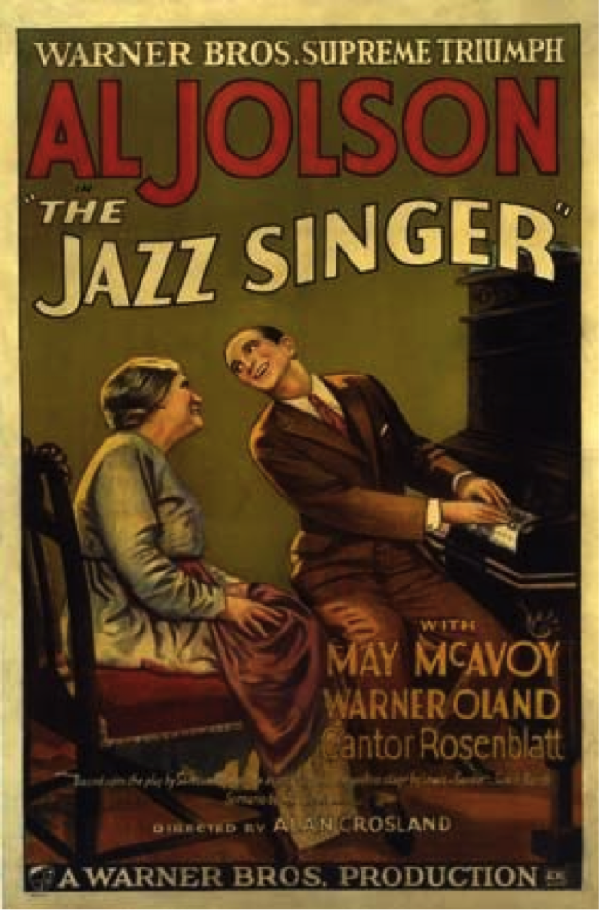
The Jazz Singer release poster, 1927.
This film ushered in talkies, and signaled the decline of the silent film era.

Slide 12
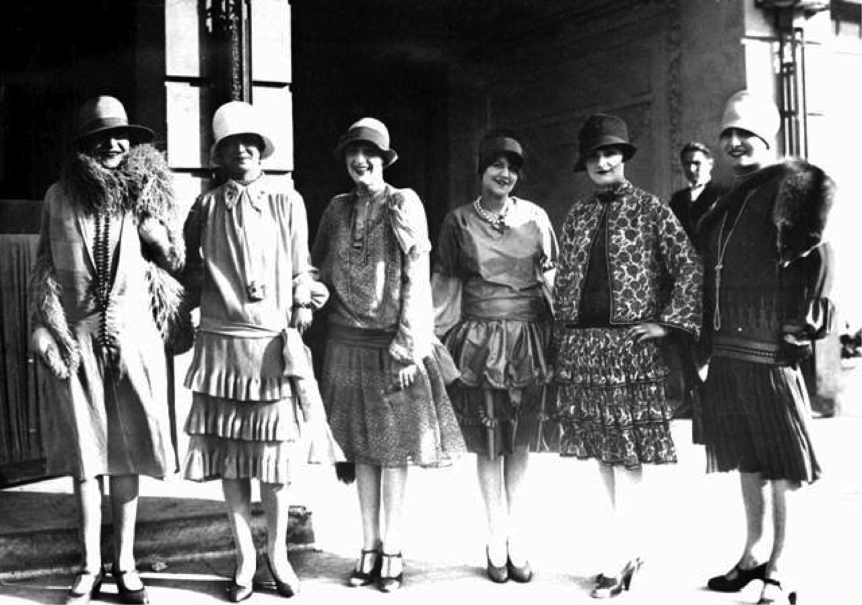
Fashion
The 1920s is the decade in which fashion entered the modern era. It was the decade in which women first abandoned the more restricting fashions of past years and began to wear more comfortable clothes (such as short skirts or trousers).

Slide 13
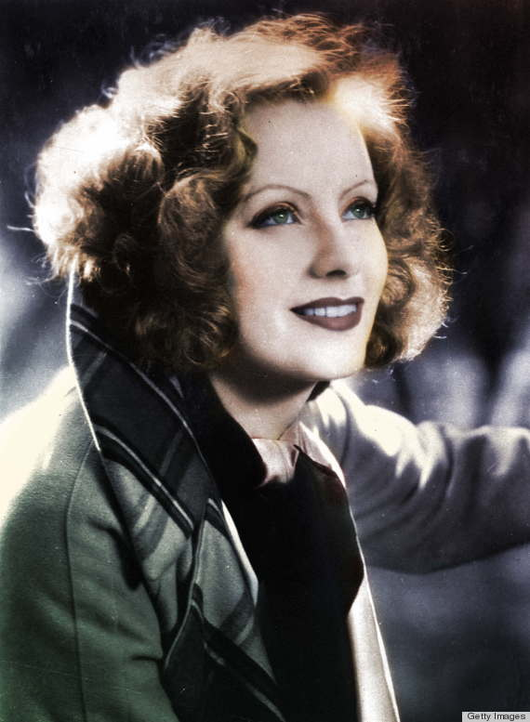
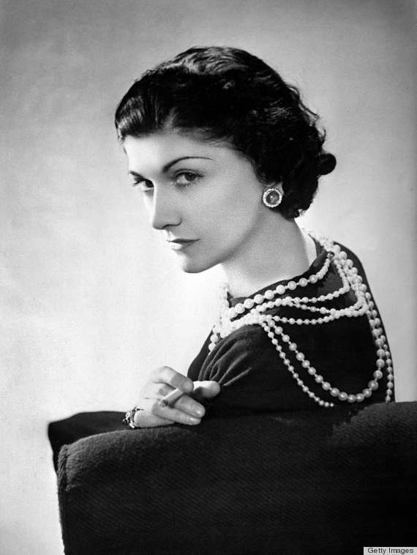
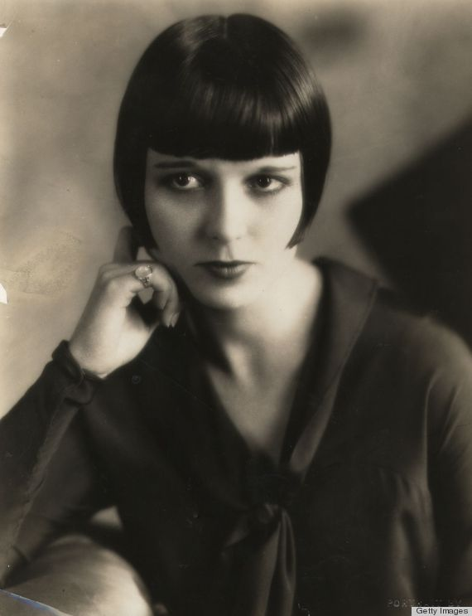
Fashion
The highlight of the '20s that exemplified change was the evolution of women's hairstyles. Ladies were saying goodbye to their long Victorian locks and welcoming much shorter hairdos.

Slide 14
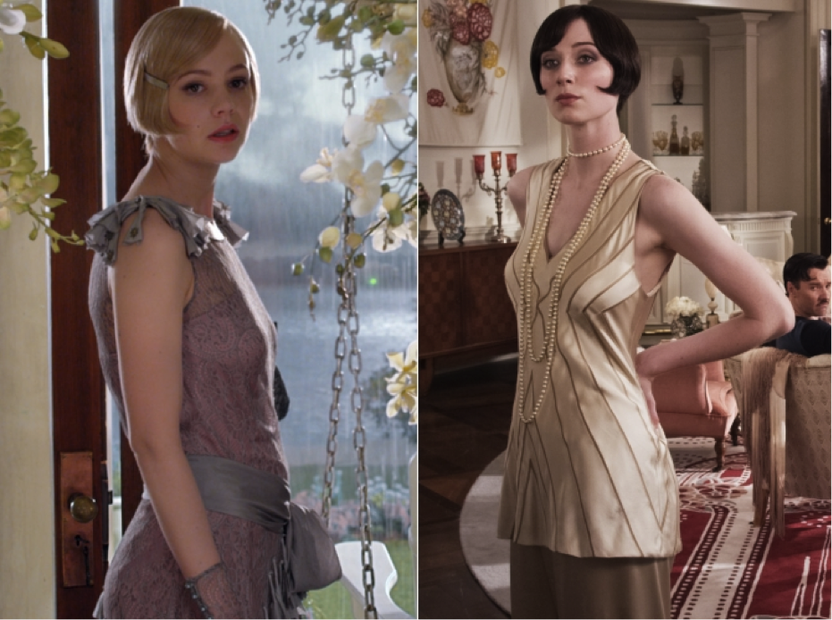
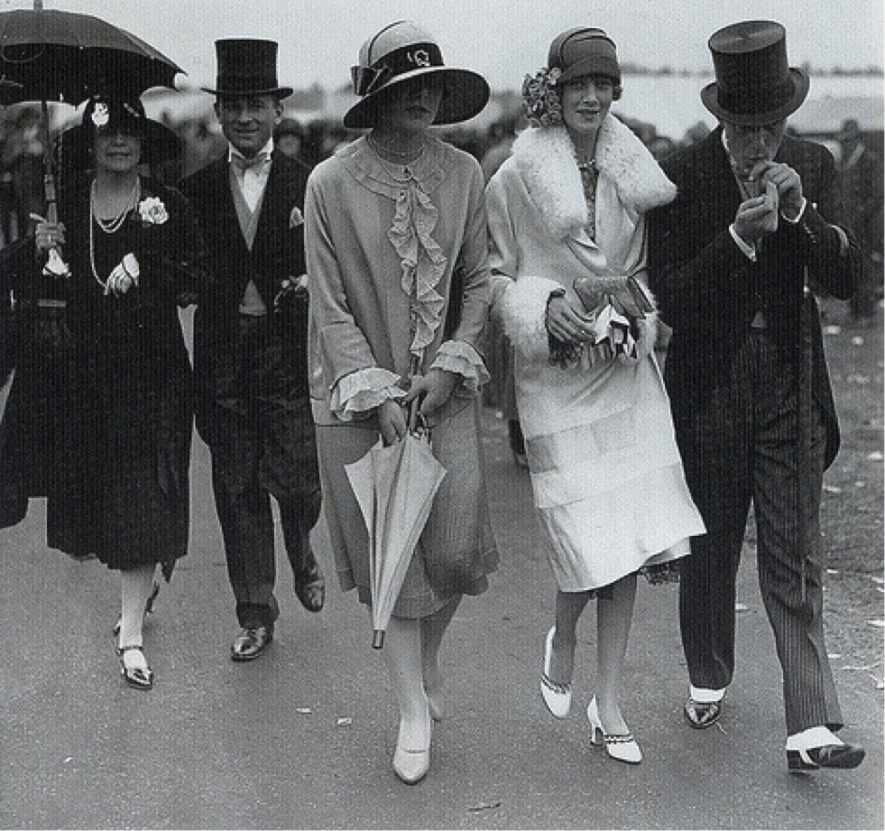
Fashion
Fantastic and beautiful coordinated and accessorized outfits were a feature of 1920’s ladies fashions. Hats, shoes, stockings, handbags, dresses and jewelry all came together in perfect harmony to create a unique and elegant style that can only be appreciated when seen in real-life or in color illustrations.
Also, Women’s fashions in the early 1920’s often referred to as the “roaring 20’s”, the era of the “flapper”.

Slide 15
Resources
http://www.huffingtonpost.com/2013/08/08/1920s-hairstyles-photos_n_3720290.html
http://www.1920-30.com/fashion/
http://www.1920-30.com/music/
http://www.ehow.com/about_6561778_history-jazz-dance-america.html
http://www.dancinunlimited.org/About%20Jazz%20Dance.html
http://www.historylearningsite.co.uk/America_economy_1920s.htm
http://www.ehow.com/info_8125807_famous-cars-1920s.html#ixzz2j7jjB54H

Slide 16
The End
Thank you for watching

