Slide 1
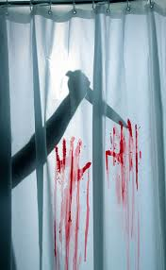
Shots and angles for a thriller/horror film

Slide 2
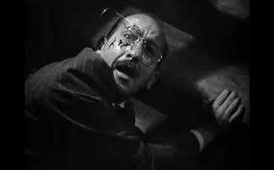
Bird eye/high angle
These kinds of shots are used in horrors and thrillers to make the figure or object that is being looked down on seem completely powerless and vulnerable.

Slide 3
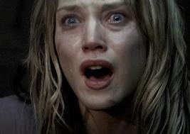
Close up
Close up’s in these types of genres are used to see reactions on the actor/actresses face. This is the shot that shows the most emotion from the characters. It is also used to capture detail in an important scene.

Slide 4
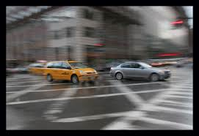
Tracking or panning shot
These shots connotes movement. This is used very effectively in horror and thriller films to make out a character is being followed or watched. It also could establish a scene so the audience can see the full view. Another great use is as the camera is moving the suspense builds up as you don’t know what could be shown next.

Slide 5
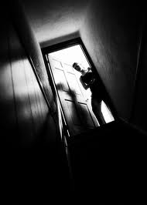
Tilted angle
Tilt shots add a lot of dramatic tension to shots, and could simplify a supernatural being, for example, pushing or moving the camera. Its also a great way to get a different shot of an incident across to the audience.
Another great use for a tilt shot is to act as though the camera is a victim on the floor, and you are seeing what they are seeing.

Slide 6
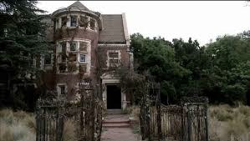
Extreme long shot or long shot
This is a great scene to use to establish horror or thriller movies. This shot could put into perspective how deserted and town is

Slide 7
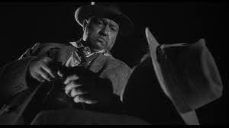
Low angles
Low angle shots are very powerful in the way they can emphasize just how scary or intimidating a villain is. This could make you as the audience as well as the actors/actresses in the film feel weak and insignificant.

Slide 8
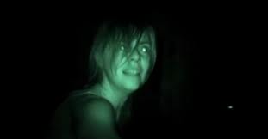
Hand held camera shot
This is use very often in horror/thriller films to add a sense of reality. It makes the audience feel involved and adds to the horror of the scene as you feel like you are there.

Slide 9
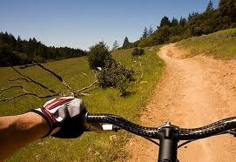
Point of view shot
This shot is taken from the point of view of the character. This is when the audience is able to see the film through the eyes of one character. This is popular in these types of movies as the audience becomes emotionally attached and more scared as the gun could be directly point at them for example.

Slide 10
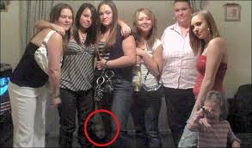
Zoom
This adds to the dramatic effect and creates element of suspense and fear as you don’t know what you are going to see next. It could also be used to zoom into something gory or gruesome. One other use could be that you zoom into see something you wouldn’t of spotted before like a supernatural being.

Slide 11
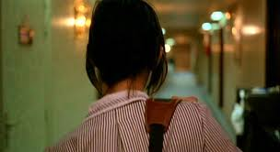
Over the shoulder shot
This is one of the best shots to build tension. This is used a lot in horrors and thrillers to add suspense, and is used especially around mirrors and reflections so the audience can see what's happening as soon as the character does. This is used a lot to show a figure stood behind a victim.

Slide 12
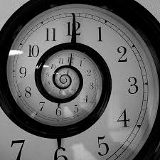
Reverse
This type of shot could also be very effective in thrillers and horrors as it could show consequences of actions and what would happen if you went back in time. It shows a character undergoing realization and the suspense is built up. Its also a great way to signify flash backs.

