Slide 1
Noun clause
Prepared by:
Rigor R. Suguitao

Slide 2
CLAUSES

Slide 3
CLAUSE
a group of words with a subject and a verb.

Slide 4
Two kinds of clauses :
INDEPEDEPENDENT CLAUSES
DEPENDENT CLAUSES

Slide 5
INDEPENDENT CLAUSE
Has a subject and a verb
Can stand by itself as a complete sentence

Slide 6
ExampleS:
The ice melted.
Mr. Smith arrived at the airport early this morning.
We must find a new strategy.
I play basketball.

Slide 7
Some sentences contain two or more independent clauses.
For example:
Mr. Smith arrived early this morning, but I didn’t meet him.
We must find a new strategy, or we will lose our advantage.
I play basketball, George plays baseball, and Fred plays tennis.

Slide 8
DEPENDENT CLAUSES
functions not as a sentence but as a part of speech (a noun or an adjective or an adverb). Therefore, it cannot stand alone as a sentence.
It is attached to some part of an INDEPENDENT clause.

Slide 9
Three types of Dependent Clauses:
Noun clauses
Adjective clauses
Adverb Clauses

Slide 10
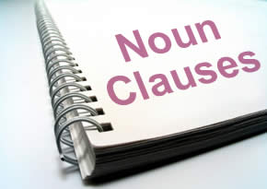
Noun clause

Slide 11
WHAT IS A NOUN?
Definitions of Noun
The English word “noun” comes from the Latin ‘nomen’ meaning ‘name’. The function of noun is to name someone or something.
According to Oxford Dictionary (Pearsall, 1999:945), noun is a word used to identify any of a class of people, places or things, or to name a particular one of these.
It can be concluded that noun is a word that functions to identify someone or something.

Slide 12
WHAT IS A CLAUSE?
Definition of Clause
A clause is a group of related words. It contains a subject and a verb (Betty, 1993:346).
Clause is a group of words that contains a subject and a verb. it can take the place of different parts of speech (http://esl.lbcc.cc.ca.us/eesllessons/nounclauses/nounclause.htm).

Slide 13
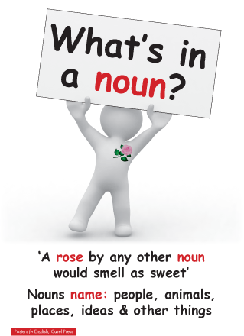
NOUN CLAUSE
Definition of Noun Clause
A noun clause is a dependent clause and cannot stand alone as a sentence (Betty Schrampfer Azar, 1993:346).
In a noun clause, the full subject and predicate are retained. The noun clause fills the same position and serves the same function as noun
act as simple nouns and identify persons, places, things, etc.
So, it can be concluded that noun clause is a dependent clause that has function as a subject, object, or complement.

Slide 14
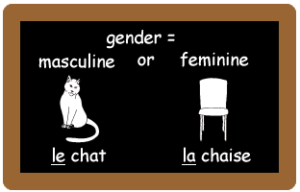
They are introduced by words such as:
how if that
whether which who
what when
where whomever whose why
whom

Slide 15
FUNCTIONS OF NOUN CLAUSE:
Subject
Subject complement
Direct object
Object complement
Object of the preposition
Adjective phrase complement
Appositive

Slide 16
1. NOUN CLAUSE AS THE SUBJECT OF A SENTENCE:
The first grammatical function that noun clauses perform is the subject. A subject is a word, phrase, or clause that performs the action of or acts upon the verb
Example:
Whoever ate my lunch is in big trouble.
How you will finish all your homework on time is beyond me.
That the museum cancelled the lecture disappoints me.
For you to not graduate from college now is such as shame.

Slide 17
2. NOUN CLAUSE AS subject complement:
A subject complement is a word, phrase, or clause that follows a copular, or linking, verb and describes the subject of a clause. The terms predicate nominative and predicate noun are also used for noun clauses that function as subject complements.
Examples:
The truth was that the moving company lost all your furniture.
My question is whether you will sue the company for losses.

Slide 18
3. Noun clause as direct object:
A direct object is a word, phrase, or clause that follows a transitive verb and answers the question “who?” or “what?” receives the action of the verb.
Examples:
The counselor has been wondering if she chose the right career.
Do you know when the train should arrive?
Our dog eats whatever we put in his bowl.
I would hate for you to get hurt.

Slide 19
4. noun clause as object complement:
Object complements are defined as words, phrases, and clauses that directly follow and modify the direct object.
Examples:
Her grandfather considers his biggest mistake that he did not finish college.
The committee has announced the winner whoever wrote the essay on noun clauses.

Slide 20
5. noun clause as prepositional complement:
The sixth grammatical function that noun clauses perform is the prepositional complement. A prepositional complement is a word, phrase, or clause that directly follows a preposition and completes the meaning of the prepositional phrase.
Examples:
Some people believe in whatever organized religion tells them.
We have been waiting for whoever will pick us up from the party.

Slide 21
6. noun clause as adjective phrase complement:
An adjective phrase complement is a phrase or clause that completes the meaning of an adjective phrase.
Examples:
I am pleased that you are studying noun clauses.
The toddler was surprised that throwing a tantrum did not get him his way.

Slide 22
7. noun clause as appositive:
An appositive is a word, phrase, or clause that modifies or explains another noun phrase.
Examples:
That man, whoever is he, tried to steal some library books.
The problem, that the storm knocked out power, is affecting the entire town.

Slide 23
Activity (Individual portfolio) Identify Noun Clauses underline the noun clause and state it’s function
You know that you’re the fastest runner on the team.
Whoever wins tomorrow’s race will compete in the county meet.
A better long jumper is what we need most on this team.
Coach Lazdowski certainly knows when she can get the maximum effort out of us.
What she does with this team is quite impressive.

Slide 24
Cont.
Why Jimmy didn’t try out for the team is beyond me.
Why can’t we just make whoever is qualified part of this team?
Only the individual involved can decide whether he or she will try out for a team.
Please give whoever tries out next year lots of encouragement.
Sometimes, the problem is deciding which of two teams to join.

