Slide 1
Infinitive PhRase

Slide 2
( to+V base form)
Infinitive Phrase

Slide 3
To live a simple life
To be smart in many areas of study
To take care of young students

Slide 4
subject
to modify an adjective
object
Infinitive phase
modifier to show purpose
complement

Slide 5
1) ( subject)

Slide 6
To be smart in many areas of study depends on self-discipline to be a life-long learner.

Slide 7
To take care of young students is a big challenge for a new teacher.

Slide 8
2) ( object)

Slide 9
We hope to live a simple life without competition.

Slide 10
Students want to be smart in many areas of study.

Slide 11
allow | force | teach | order | tell | implore
permit | encourage | hire | convince | appoint | expect*
instruct | remind | invite | ask | require | want*

Slide 12
Our neighbor invites | us | to have dinner with him every Friday .
Please remind | me | to check the flight schedule before leaving .
Did your friend tell | you | to do homework ?
I expect | you | to take care of young students .

Slide 13
3) ( complement)

Slide 14
The dream of many businessmen is to live a simple life without competition .

Slide 15
Narisa's wish is to be smart in many areas of study .

Slide 16
Siri's goal in becoming a teacher is to take care of young students .

Slide 17
5)
( to modify an adjective)

Slide 19
6
( to modify a noun or a pronoun)

Slide 20
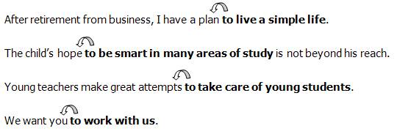

Slide 21
Thank you

