Slide 1
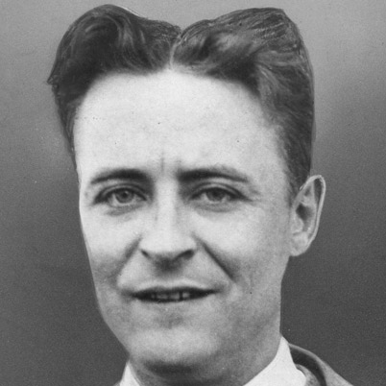
F. Scott Fitzgerald & The lost Generation
Alycia, Emma, Mallory, Tiffany

Slide 2
F. Scott Fitzgerald (1896-1940)'s Turbulent Life (I)
Began life as the son of a failed salesman
To New Jersey: Showed Writing talent in high school
To Princeton University: Focused on honing writing skills, but became unlikely to graduate
Joined US army: Wrote a book in case he died in WW1 (Rejected)
To Alabama: Met Zelda, who he fell in love with

Slide 3
F. Scott Fitzgerald's Turbulent Life (II)
To NYC: Searched for jobs, married Zelda and had 1 child
To St Paul: Wrote more stories and became famous
Lived as an extravagant celebrity
BUT he became in debt
Became an alcoholic and suffered from depression
Died halfway through writing final novel
* AFTER death, now looked on as one of the most fantastic, truthful authors in the history of American literature, mostly due to the Great Gatsby

Slide 4
Important Influences on F. Scott Fitzgerald's Life
Father Sigourney Fay:
Found out Fitzgerald’s talent on his writing
Encouraged Fitzgerald to keep writing
Detective stories:
Published them when he was in high school
Encouraged him to write more enthusiastically
Aspiration:
Spent almost whole life to catch his dream, to reach his aspiration

Slide 5
Important Influences on F. Scott Fitzgerald's Life
Writing:
Because of writing he became famous and he became rich.
Made him marry with Zelda Sayre Fitzgerald.
Alcohol:
Damaged the relationship between him and his wife
Damaged his health

Slide 6
The Lost Generation
The “Lost Generation” refers to people who were born between 1883 and 1900. The idea was first introduced by Ernest Hemingway in his book, “The Sun also Rises”.

Slide 7
The Lost Generation
The men who experienced World War 1
Grew up quickly
Independent and Self-sufficient
Proud of themselves ☞ Expected to be treated as heroes
Cynical about humanity since the government ignored them
Sought for libertinism and happiness without taking responsibilities ☞ Gangsters, speakeasies and hedonism
Didn’t believe in traditional values/Believed returning home is no longer necessary
Nomadic

Slide 8
Influence of Literature
After the war, American writers
lost and aimless
moved to Paris to find the meaning of life and escape from the mess in their hometowns.

Slide 9
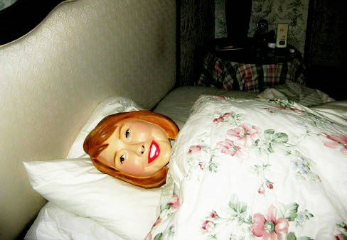
Thanks for Watching

Slide 10
Work cited
"Francis Scott Key Fitzgerald." Bio. A&E Television Networks, 2014. Web. 16 Oct. 2014. <http://www.biography.com/people/f-scott-fitzgerald-9296261>.
Bruccoli, Matthew J. "Biography of F. Scott Fitzgerald." N.p., Web. 16 Oct. 2014. <http://www.fscottfitzgeraldsociety.org/biography/>.
Jaracz, Jill. "How the Lost Generation Works" 23 May 2011. HowStuffWorks.com. 15 October 2014. http://people.howstuffworks.com/culture-traditions/generation-gaps/lost-generation.htm
Willett, Erika. "The Sensible Thing: Biographies." PBS: Public Broadcasting Service. N.p., n.d. Web. 16 Oct. 2014. <http://www.pbs.org/kteh/amstorytellers/bios.html>.

