Slide 1
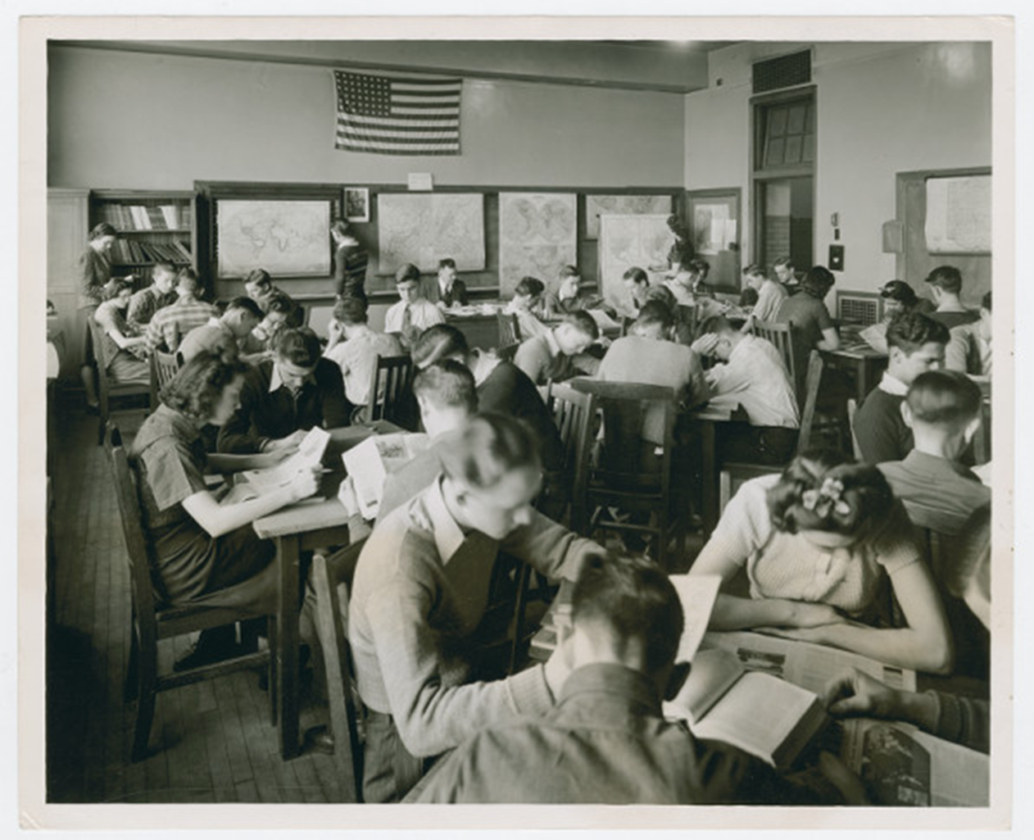
What is History?
A list of
Dates,…
Names,…
Places,…
Facts,…
Events?

Slide 2
What is History?
History is an account of the past
Accounts differ depending on one’s perspective
We must rely on evidence to construct accounts of the past.
We must question the reliability of each piece of evidence.
Any single piece of evidence is insufficient to build a plausible account.

Slide 3
Elements of Historical Thinking
1. Multiple Accounts & Perspectives
2. Analysis of Primary Sources
3. Sourcing
4. Understanding Historical Context
5. Claim-Evidence Connection

Slide 4
Reading Like a Historian Sourcing Close reading Corroboration Contextualization

Slide 5
Consider the source: Who made this document? When? Who was it made for? How was it made? How was it disseminated? What is its message or argument?

Slide 6
Consider the source Close reading: What choices did the creator of this document make? What do those choices say about the past? How might this document have looked different?

Slide 7
Consider the source Close reading Corroboration: What other texts appeared at this moment? How do they support or complicate this document? What do the disagreements tell us?

Slide 8
Consider the source Close Reading Corroboration Contextualization: What was going on when this document appeared? How did those events affect its creation?

