Slide 1
Infographic Design
Adapted from:
Neo mammalian studios
http://submitinfographics.com/all-infographics/8-factors-of-a-good-infographic.html

Slide 2
What is an infographic?
Uses visual elements and text to quickly convey information
Simple example:

Slide 3
Types of infographics

Slide 5
Types of infographics

Slide 7
Types of infographics

Slide 9
Types of infographics

Slide 11
Types of infographics

Slide 13
Types of infographics

Slide 15
Types of infographics

Slide 17
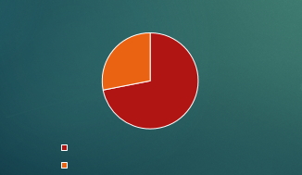
Tips for infographics
Use the visuals deliberately
Check: if you can take all of the text out, does it still make sense?

Slide 18
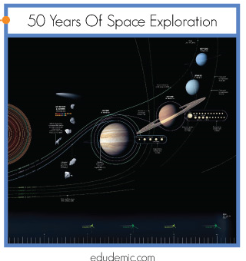
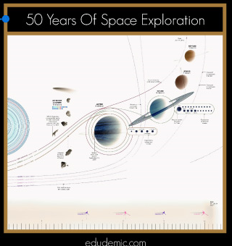
Tips for infographics
Pick a good color palette
Tricky to define, but you know it when you see it

Slide 19
Tips for infographics
Have a clear story
Infographics should be quick to convey info

Slide 20
How would you improve this?

Slide 21
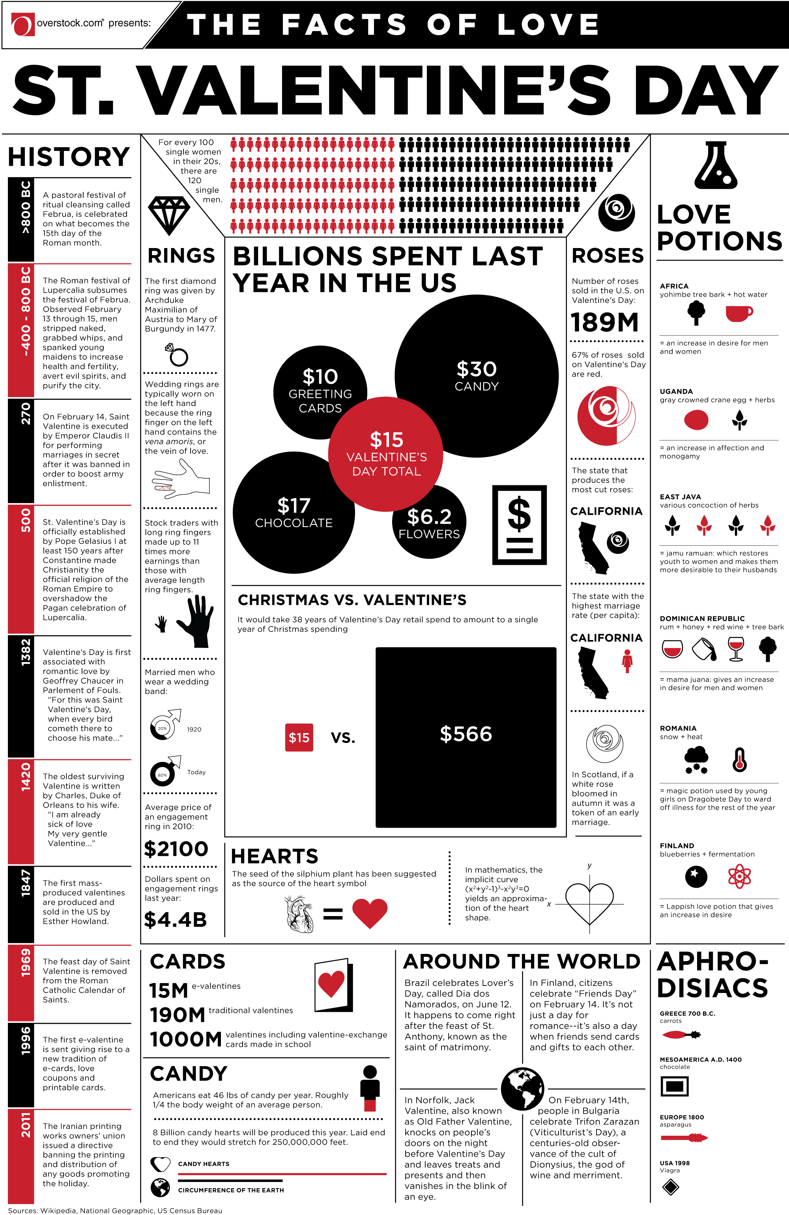
Tips for infographics
Don’t be too text-heavy
Or too busy

