Slide 1
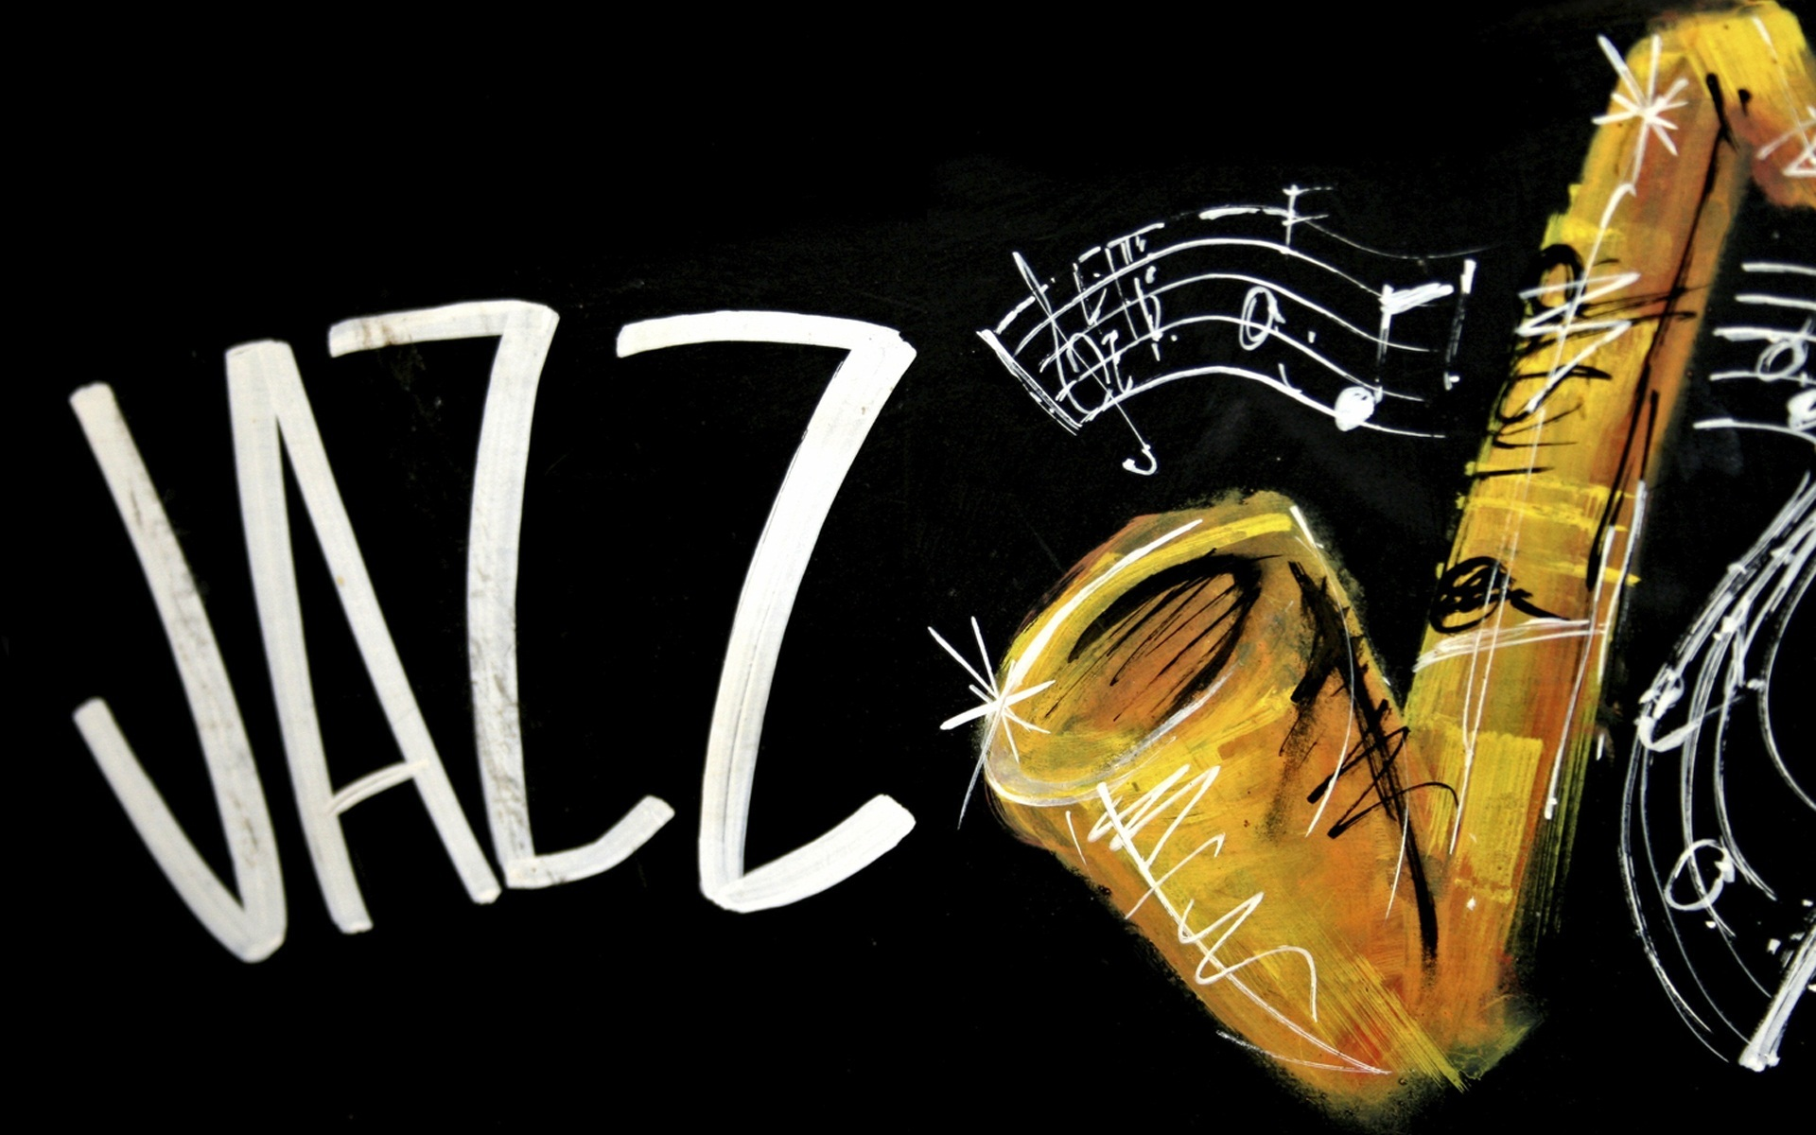

Slide 2
This is a normal night of 1927, you are driving on the street as usual, suddenly you decide to visit your favorite bar…

Slide 3
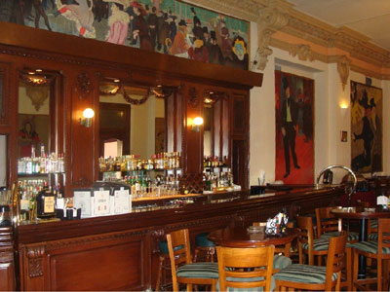
After you turned around the corner, here you go! There it is !

Slide 4
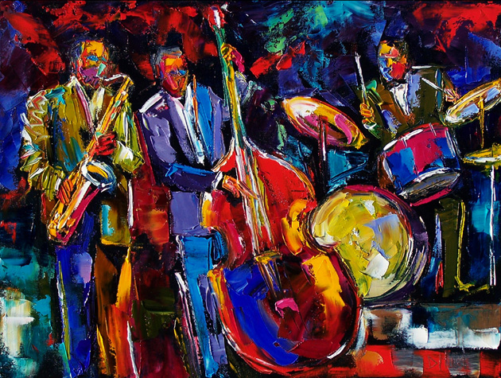
The band is playing Jazz, which exactly the song you love.

Slide 5
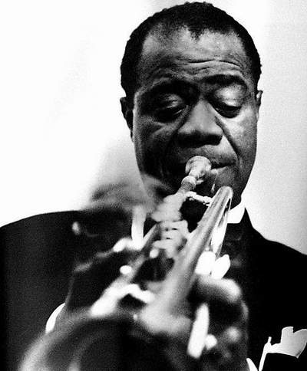
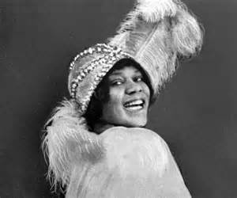
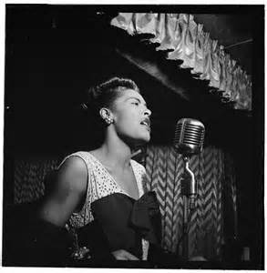
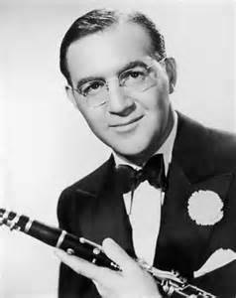
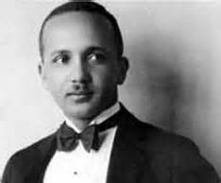
Famous jazz musicians
Louis Armstrong
Bessie Smith
Billie Holliday
Benny Goodman
Fletcher Henderson

Slide 6
Musics
Jazz was born around 1895 in New Orleans. Originally it was a mixture of Blues and marching band music and was played by African-Americans and Creoles on old U.S Army instruments like the cornet or marching drums. It is also marked through the use of improvisation, because most of the former virtuoso jazz musicians weren’t able to read music at all. Soon the white man noticed the popularity of jazz and started to play it too. Therefore the European and African music culture melted together and a new style of jazz was born.

Slide 7
A veteran is bragging about his heroic stories….

Slide 8
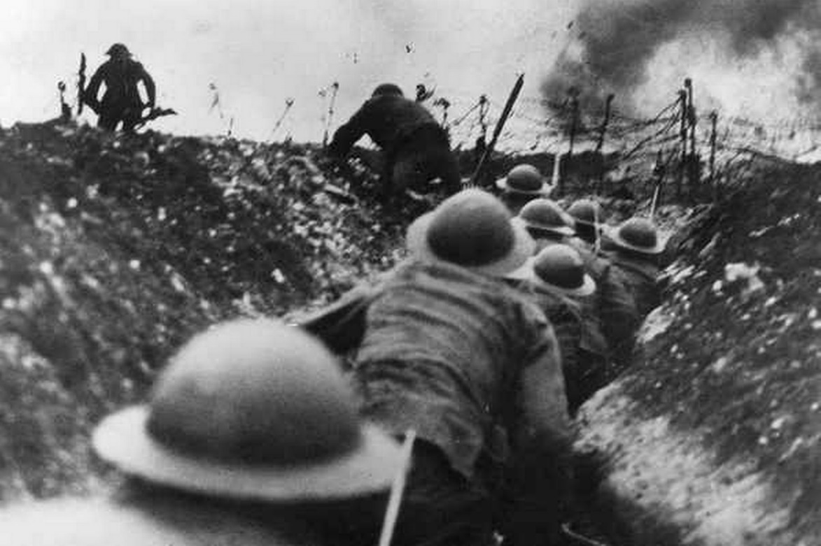
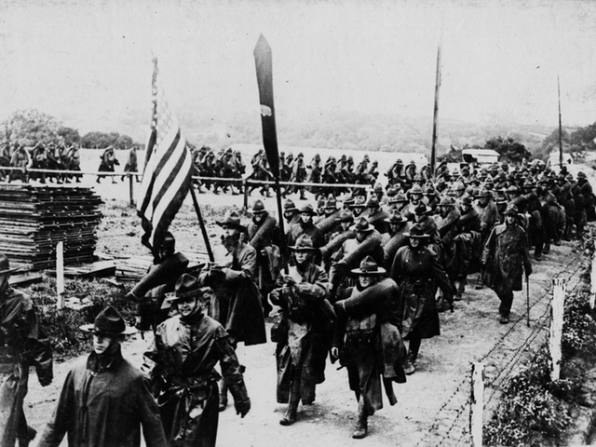
After the great war…
In 1920‘s America - known as the Jazz Age, the Golden Twenties or the Roaring Twenties - everybody seemed to have money. The 1920’s saw a break with the traditional set-up in America. The Great War had destroyed old perceived social conventions and new ones developed. The younger generation mistrusted the older generation and “did their own thing” which flew in the face of the establishment.

Slide 9
Bold trend leading by women
“Cut off all of your hair
Did you flinch, did you care
Did he look, did he stop and stare
At your brand new hair…”

Slide 10
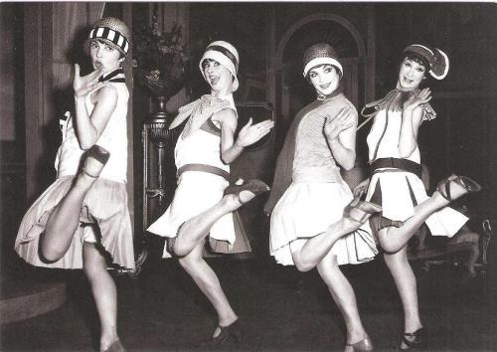
“Freedom” of women!!
The young set themselves free especially, the young women. They shocked the older generation with their new hair style (a short bob) and the clothes that they wore were often much shorter than had been seen and tended to expose their legs and knees. The wearing of what were considered skimpy beach wear in public could get the Flappers, as they were known, sometimes arrested for indecent exposure.

Slide 11
Dances of the Jazz Age
Generally, when people think about the dances of the Jazz Age (the 1920s & 30s), they bring to mind exuberant youth dances like the Charleston or Jitterbug, or the theatrical dances of Fred and Ginger. The most popular dance of the period was the Foxtrot. The Waltz and the Tango were also widely danced, as were (in the '30s) Latin dances like the Rumba, Conga and Samba.

Slide 12
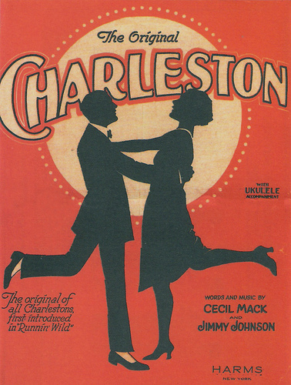
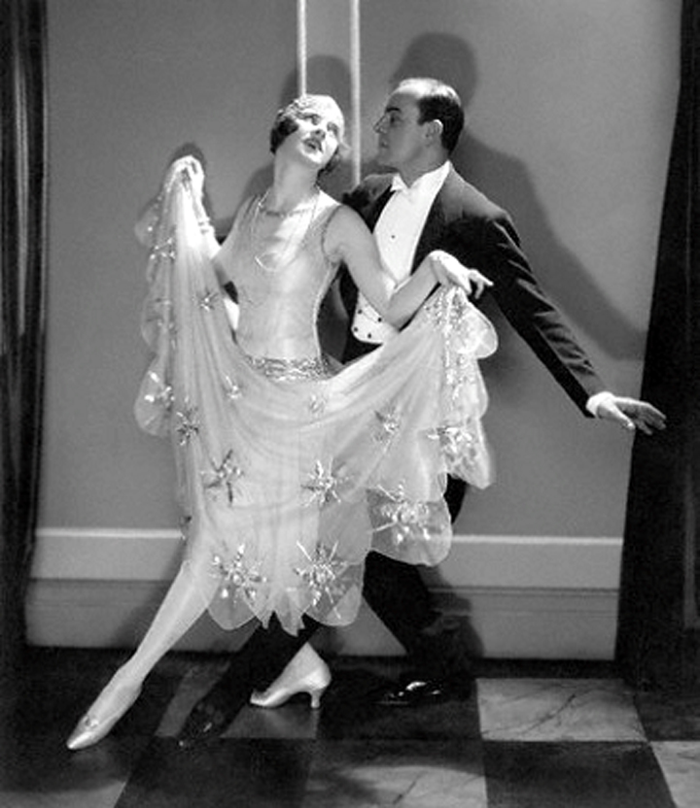
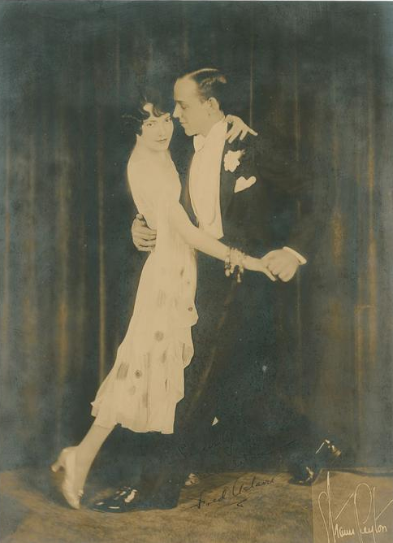
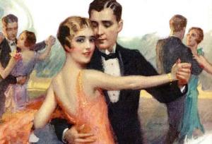
While they differ from what is taught today, they differ primarily in that the Jazz Age dances (referred to at the time as "The Modern Dances") were FAR EASIER than their current descendents. An experienced dancer will pick them up right away, and most beginners should be able to get out on the floor with a minimum of instruction - perhaps even after just looking at these few web pages.
Easy Dance

Slide 13
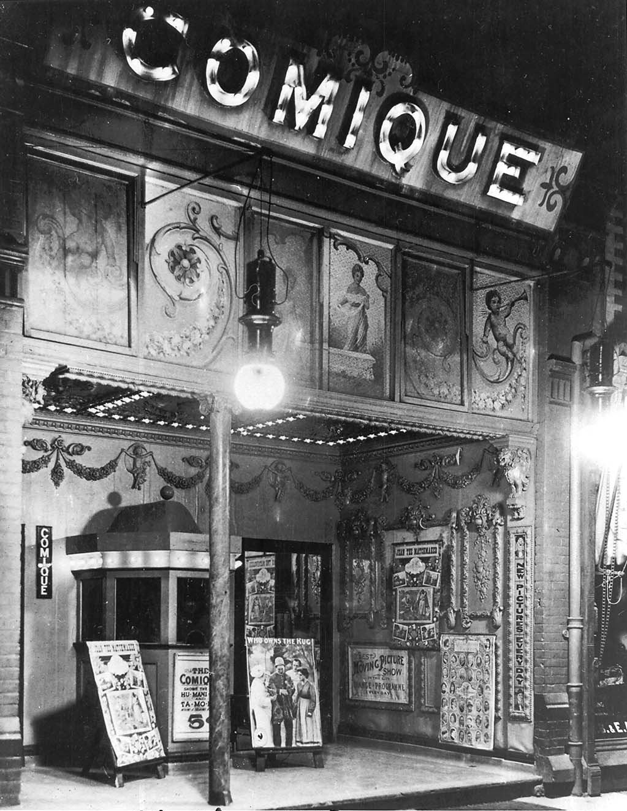
It’s time to go, but the coming out movie poster
attracts your eyes.

Slide 14
The Plastic Age is a 1925 black-and-white silent film, starring Clara Bow, Donald Keith, and Gilbert Roland in his film debut. The film survives today not only on 16 mm film, but also on video and DVD. The film was based on a best-selling novel from 1924 of the same name, written by Percy Marks, a Brown University English instructor who chronicled the life of the fast-set of that university and used the fictitious Sanford College as a backdrop. The Plastic Age is known to most silent film fans as the very first hit of Clara Bow's career, and helped jumpstart her fast rise to stardom.

Slide 15
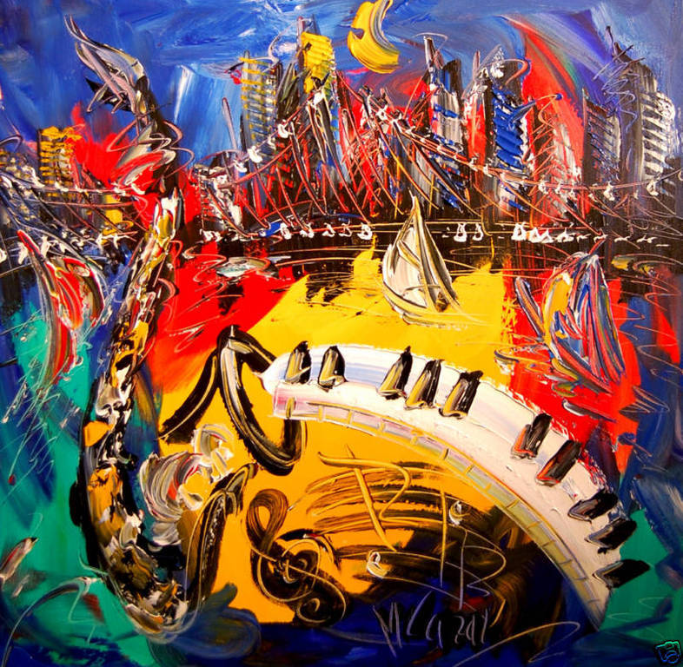
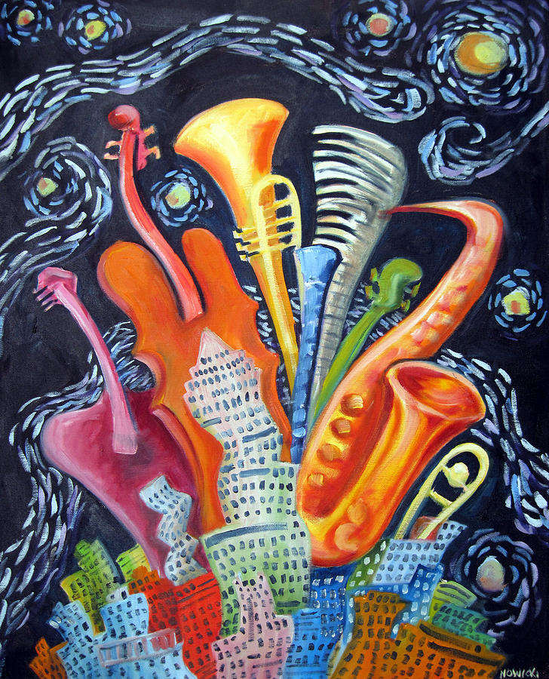
Movies
TAG:
REALISTIC/FETALISM/ROMANTIC/COMPARISON BETWEEM RICH AND POOR

Slide 16
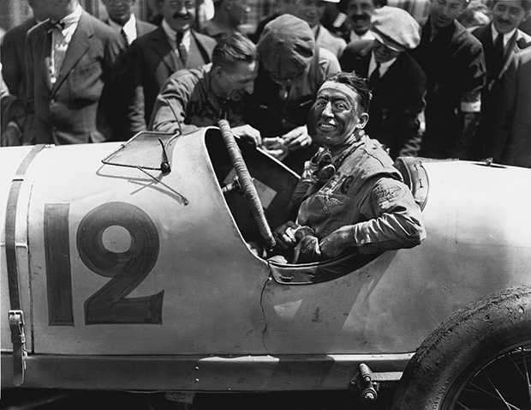
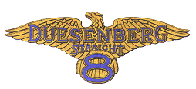
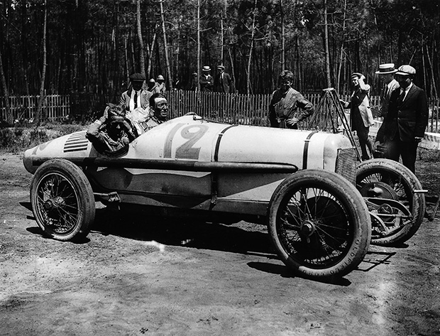
Cars-Duesenberg 183 Grand Prix
People around the cinema, holding newspapers, all talking about the winner of the latest Grand Prix League. ..

Slide 17
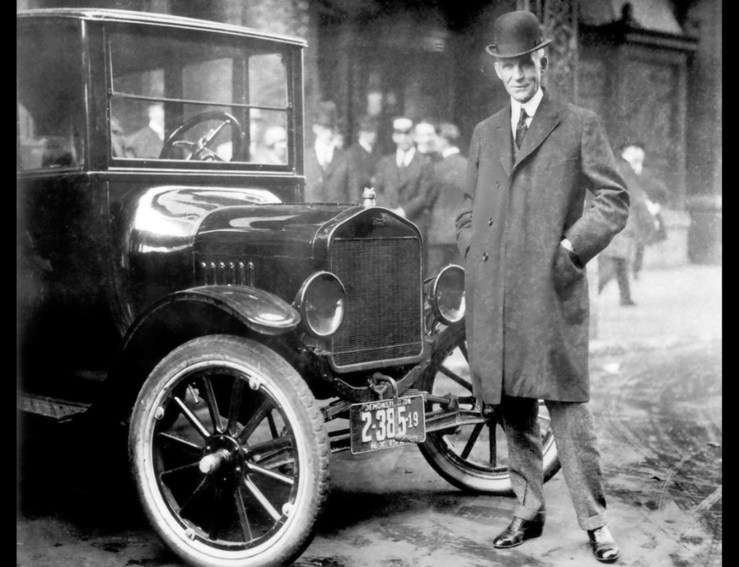
It’s very late and you decide to go home, by your favorite MODEL T.

Slide 18
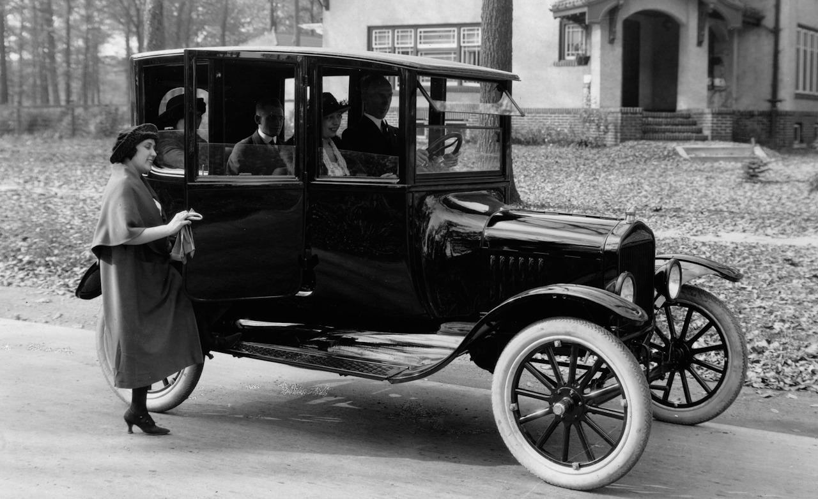
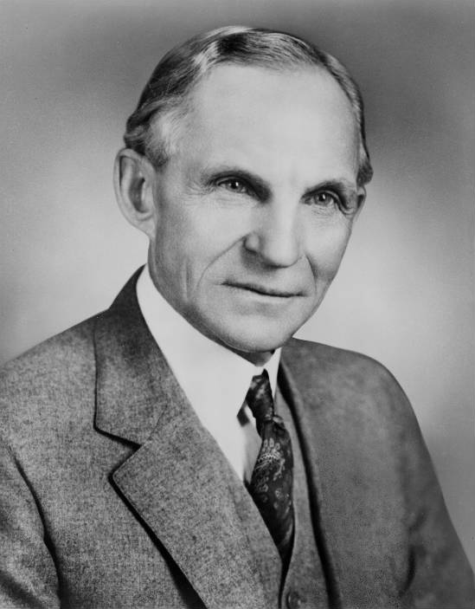
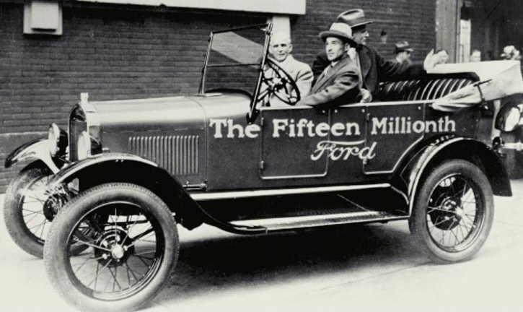
Cars-FORD MODEL T

Slide 19
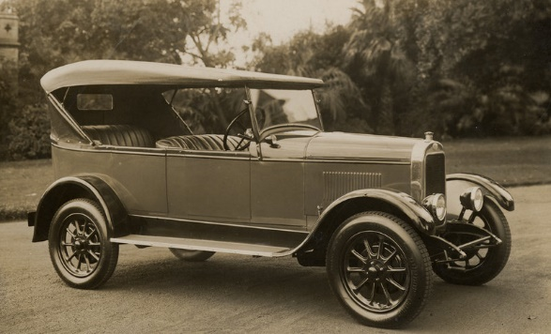
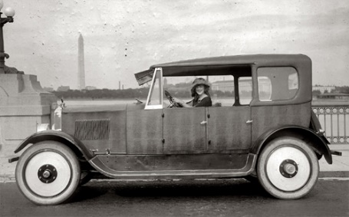
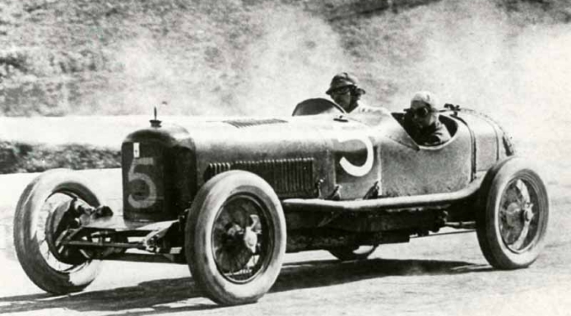
Cars
1920s Clyno Motor Car
1921. Margaret Gorman, the First Miss America, in a Birmingham car
1921 Maserati Tipo 26

Slide 20
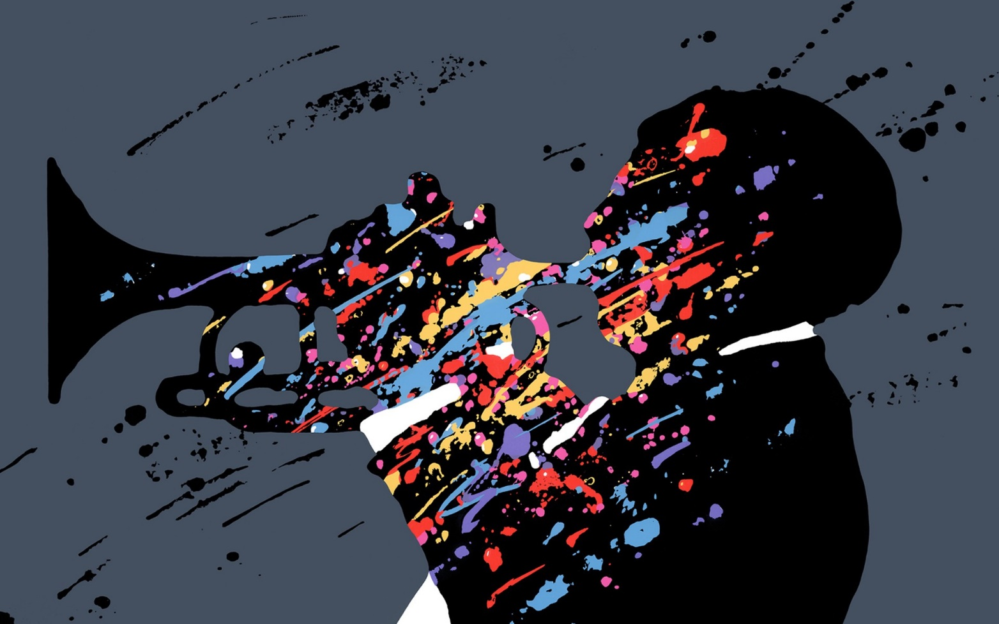
And you said to yourself , ” Man, you would never get tired of listening to Jazz!!”

