Slide 1
Prohibition and organized crime
Cash Barnes, Wendy Hayashi, Eileen Guo.

Slide 2
What is prohibition?
Prohibition was a period of nearly fourteen years of U.S. History in which the manufacture, sale, and transportation of liquor was made illegal. It led to the first and only time an amendment to the U.S. Constitution was repealed.
It is also known as the noble experiment
Dates; 1920 – 1933.

Slide 3
Why prohibition?
The temperance movement blamed alcohol for many of society's ills, especially crimes and murder.
Members of the temperance movement urged, would stop husbands from spending all the family income on alcohol and prevent accidents in the workplace caused by workers who drank during lunch.

Slide 4
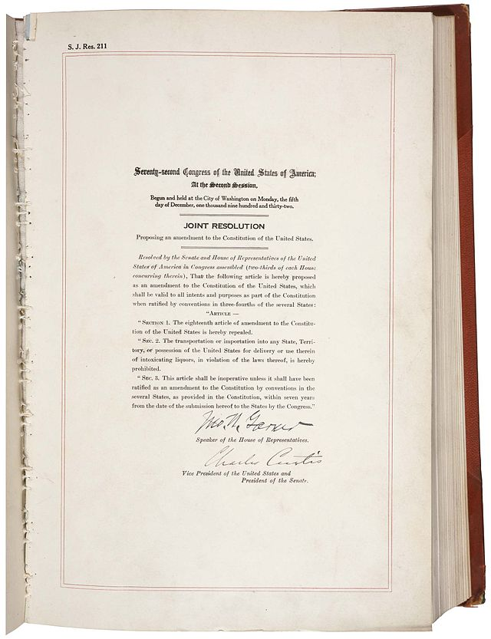
Related amendments

Slide 5
How did prohibition influence the 1920’s?
The closure of alcohol related businesses led to a huge percentage of unemployment. People were struggling to feed their families and had to trade alcohol illegally.
Illegal alcohol meant quick money.
Bribes were common.
People threated great criminals as heroes.
Led to the increase of crime rates.

Slide 6
How Prohibition led to the rise of Organized crime

Slide 7
People wanted to drink!
There were illegal ways to drink during prohibition.
Some people took notice of the amazingly high level of demand for alcohol within society and the extremely limited avenues of supply to the average citizen.
Within this imbalance of supply and demand, gangsters saw profit.
Al capone in Chicago is one of the most famous gangsters of this time period.

Slide 8
Prohibition caused corruption
Everyone from major politicians to the cop on the beat took bribes from bootleggers, moonshiners, crime bosses, and owners of speakeasies.

Slide 9
Famous criminals who organized crime…

Slide 10
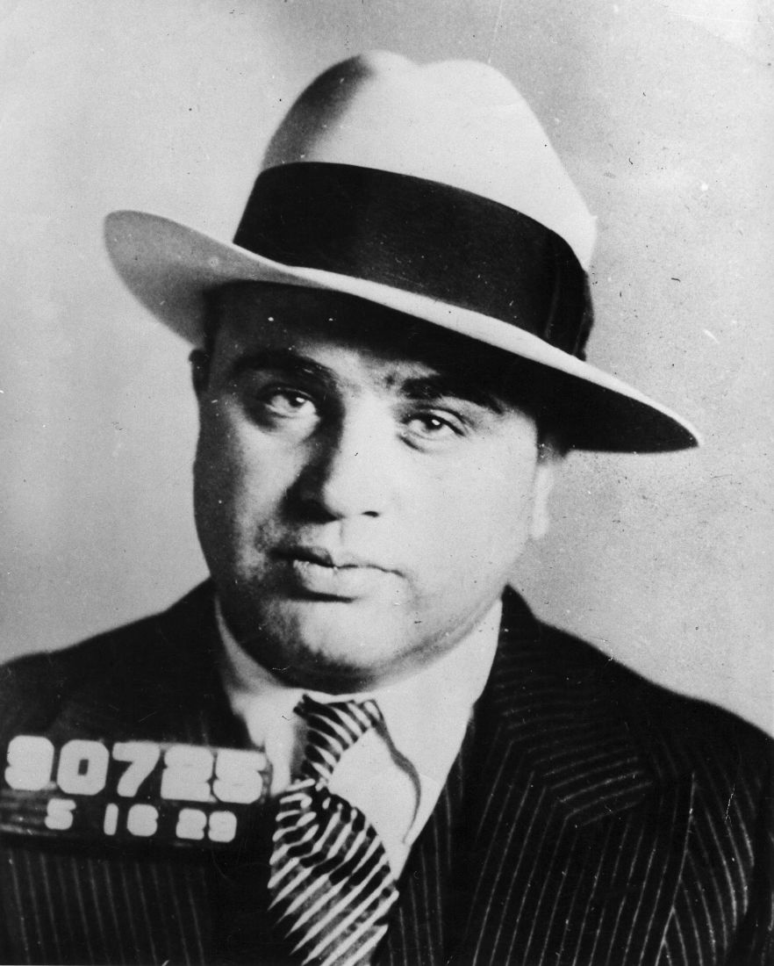
Al Capone
One of the most famous American gangsters, al capone who is also known as "scarface
" Rose to the leader of the Chicago mafia during the prohibition era.

Slide 11
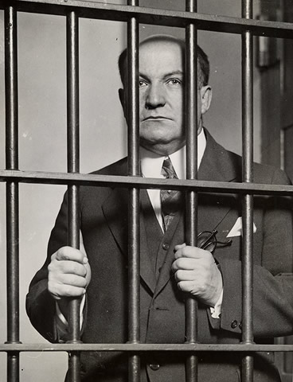
George Remus
A lawyer who broke the law and became known as “king of the bootleggers.
By buying bonded whiskey used for medicinal purposes, and then hiring people to hijack it, remus made $40 million in less than three years, nearly a billion in today’s currency.

Slide 12
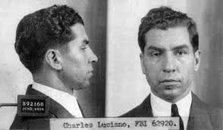
Charles Luciano
Charles “lucky” luciano is widely credited as the father of modern organized crime, splitting the New York mafia into five families.

Slide 13
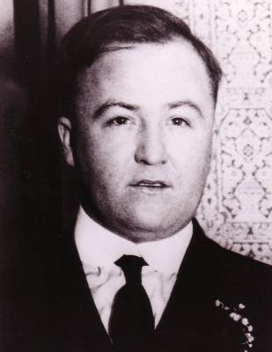
Dean O’Banion
A New York-based Irish gangster, dean o’banion was crazy enough to steal from Charles Luciano and other more powerful mafia members.
That didn’t work out so well for him: he got murdered at his flower shop after ignoring a “back off” from al capone about a powerful mafioso's gambling debt.

Slide 14
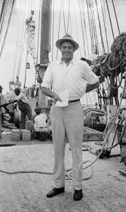
William McCoy
He spawned the term “the real mccoy,” because his liquor was never diluted. But since it was so high-quality, mccoy made enemies out of both the U.S. Government and other bootleggers.

Slide 15
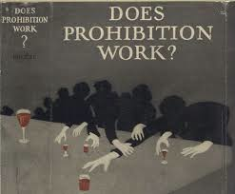
Speakeasies
Speakeasies were well-hidden places, usually in basements, where alcoholic beverages would be served.
Ironically, one of the best speakeasies was bridge whist club, which was owned and operated by the united states government.

Slide 16
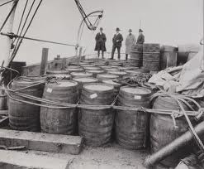
Rum-runners
Rum-runners was the name given to the smugglers, although they transported more than just rum…
Rum-running was dangerous. The liquor would be shipped from Canada across the great lakes, and when arriving in the united states anything could happen. For one, the coast guard could catch the smuggler. He might also be robbed of his liquor, or he could be killed for his liquor as well by his 'customer'.

Slide 17
Bootlegging
Illegal alcohol manufactured in the united states or internationally.

Slide 18
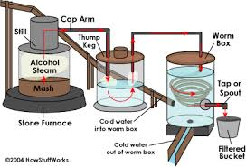
Moonshine
Moonshine, home produced alcohol or whiskey, used a still for distillation. Producers and smugglers usually worked by "moonshine" to avoid detection.

Slide 19
Bibliography
http://guycodeblog.mtv.com/2012/12/05/5-most-insane-bootleggers-of-prohibition/
http://history1900s.about.com/od/1920s/p/prohibition.htm

Slide 20
Thanks for watching

