Slide 1
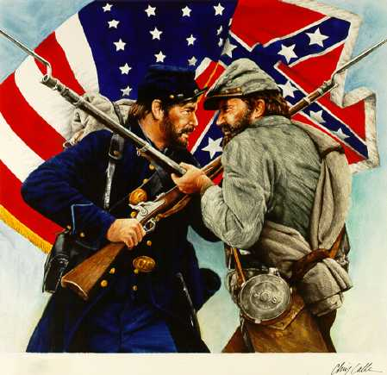
The American Civil War: Causes, Conflicts, and Consequences

Slide 2
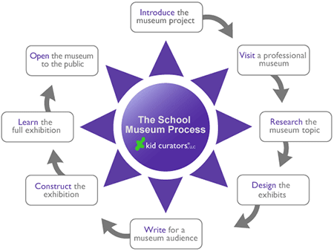

Slide 3
Calendar
Week 1 – Topic Selection/Xiehe Museum Visit
Week 2 – Develop Subtopics/Research
Week 3-5 -Research
Week 6 – Design the museum
Week 7 – Writing for the museum/Virtual Guide
Week 8 – Learn the exhibit/Present in class
Week 9 – Presentation Week

Slide 4
Elements of the Exhibit
One main topic and 4 subtopics
A storyline that guides the visitor
A Historical Question
A Map
A timeline of significant events
4-5 Biographical Profiles of a historical people
Artifacts related to the topic and subtopics
A digital guide
An audio guide

Slide 5
Possible Topics and Subtopics
Causes of the Civil War
Slavery
Abraham Lincoln
Abolitionists/Antislavery Movement
Underground Railroad
Women's role before, during and after the Civil War
Immigrants
Native Americans and the Civil War
African Americans
Northerners
Southerners
Slavery Abolitionists
Southern and Northern Fashion
Crucial Battles
Naval Warfare
War Technology/Weaponry
Soldiers in Battle
Children in the Civil War/Child Soldiers
Lives of Soldiers
Medical Practices in the Civil War
Spies in the Civil War
African American Soldiers
Confederate Commanders and Generals
Union Army Commanders and Generals
Music and Poetry of the Civil War.
Influence of Photography
Sharecropping system
Reconstruction/Rebuilding the South after the war
African Americans after the civil war
The Freedman’s Bureau
Carpetbagger’s and Scalawags
The Ku Klux Klan
The black codes/segregation

