Slide 1
Women in the 1920s: the Flappers
Drew, Laura, and Amber

Slide 2
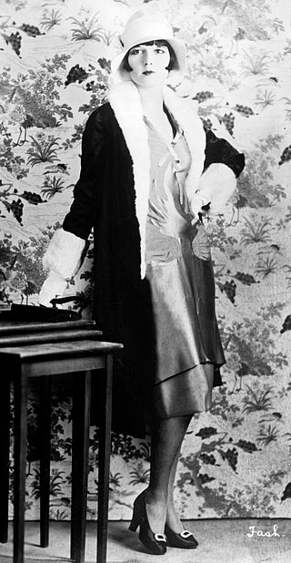
Who are Flappers
Flappers are a new generation of women in the 1920s
They broke the old tradition rules
They were fashionable.
They had short hair, makeup, short skits
They had fun-loving attitude
They smoked cigarettes and drank
alcohol

Slide 3
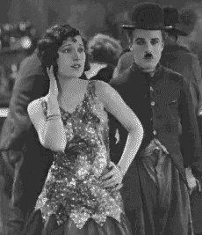
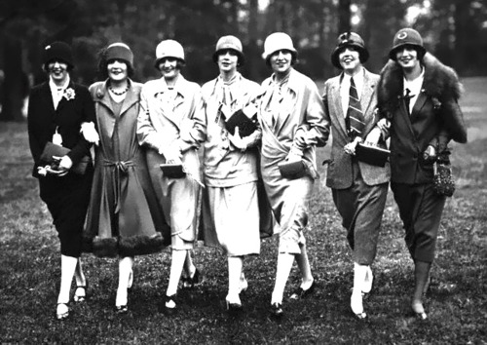
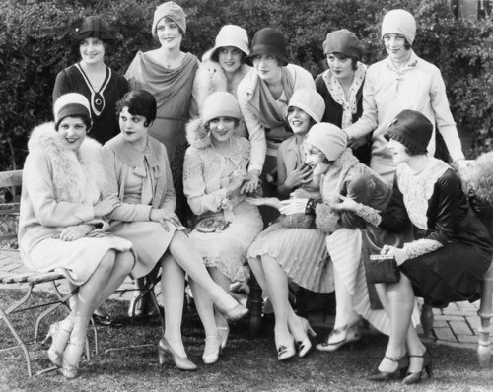

Slide 4
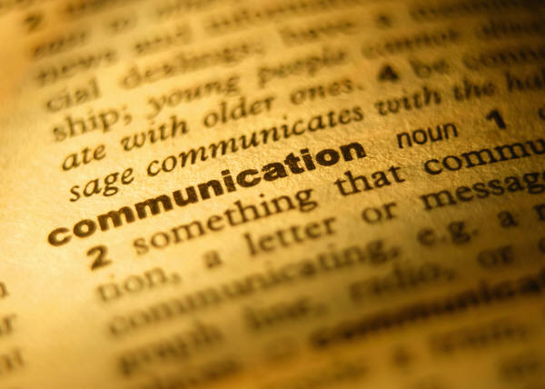
The term “Flapper”
The word “Flapper” first appeared in Great Britain after WWI
It was used to describe young girls who are not women yet. They sometimes have awkward movements.

Slide 5
Why they became Flappers
In the past, young women didn’t date. They had to wait for proper young men come to find them.
However, when WWI happened, too many young men died on the battlefield. Therefore, women can no longer wait for men to find them.
The young generation started to break away from old values and became Flappers.
Then, women decided that they are not going to waste their young lives. They are going to enjoy life.

Slide 6
Aspect of woman right
In 1920, women were allowed to vote
In the age of 1920s, woman right started to increase in many aspects.
Political right
Education right
Right of working in science, art, and literature field.

Slide 7
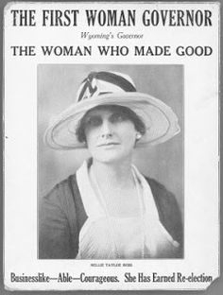
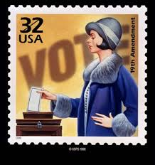
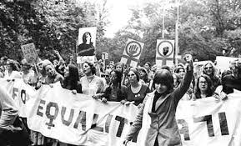
Women Suffrage
19th Amendment in 1920
Alice Paul draft
amendment to Congress
First U.S woman governor—
Nellie Tayloe Ross

Slide 8
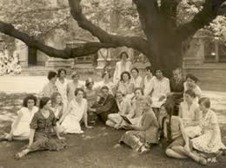
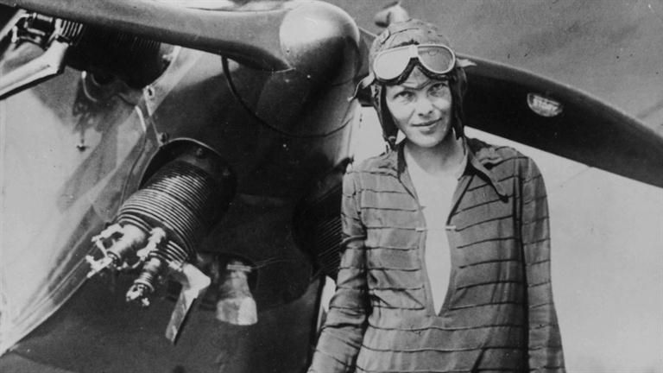
Education Right
Amelia Earhart learn her flying lesson in 1921
The Bryn Mawr Summer School for Women Workers is established in 1921

Slide 9
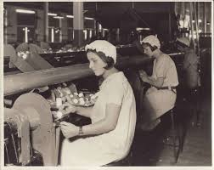
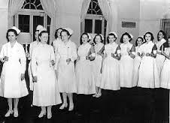
Career
North Carolina was leading to hire female workers by 1922
By 1930, one in four women held a paying job

Slide 10
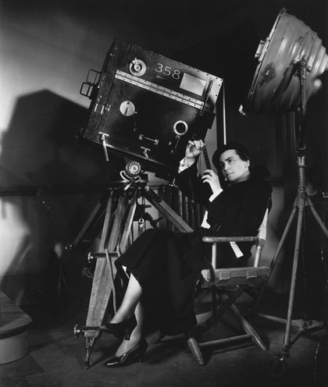
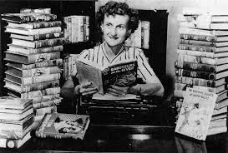
Women working in Science, Art, and Literature fields
Science
Florence Sabin became the first female member of the National Academy of Sciences in 1925
Literature
Mildred Wirt wrote Nancy Drew mystery novels in 1929
Art
Dorothy Arzner directed her first film, Fashions for Women in 1927

Slide 11
Work Cited:
http://history1900s.about.com/od/1920s/a/flappers_3.htm
http://ncpedia.org/history/20th-Century/1920s-women
http://capone.mtsu.edu/kmiddlet/history/women/time/wh-20s.html
http://www.americanhistoryusa.com/working-voting-women-1920s/

